Slide 1
Photo detection Principle
A detector’s function is to convert the received optical signal into an electrical signal, which is then amplified before further processing.
Light
I

Slide 2
Optical Detectors
Optical detectors are used to convert variation in optical power into corresponding variation in electric current.
The photodetector works on the principle of optical absorption. The main requirement of light detector is its fast response.
For fiber optic communication purpose most suited photodetectors are PIN (p – type – intrinsic – n- type) diode and Avalanche Photodiode (APD)
The performance parameters of a photodetector are responsivity, quantum efficiency, response time and dark current

Slide 3
Photodetector - Requirements
High sensitivity (responsivity) at the desired wavelength.
and low responsivity elsewhere
High fidelity. To reproduce the received signal waveform with fidelity (Example: for analog transmission the response of the photodetector must be linear with regard to the optical signal over a wide range).
Large electrical response to the received optical signal. The photodetector should produce a maximum electrical signal for a given amount of optical power.
Short response time. (pn-µsec, PIN/APD-nanosec)

Slide 4
Photodetector - Requirements
Minimum noise and reasonable cost
Insensitive to temperature variations
Stability.
Small size
Low bias voltage.
High reliability
Low cost
Long operating life

Slide 5
Photodiodes
Due to above requirements, only photodiodes are used as photo detectors in optical communication systems
Positive-Intrinsic-Negative (pin) photodiode
No internal gain
Avalanche Photo Diode (APD)
An internal gain of M due to self multiplication
Photodiodes are reverse biased for normal operation

Slide 6
Photodetector - Characteristics
1. Responsivity
Responsivity – The ratio of current output (Amp) to the incident optical power (light input) [watts].
varies with wavelength
theoretical maximum responsivity: 1.05A/W at 1300nm
typical responsivity: 0.8 - 0.9 A/W at 1300nm
formula for theoretical maximum responsivity (quantum efficiency = 100%)

Slide 7
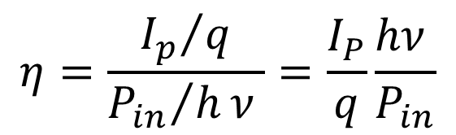
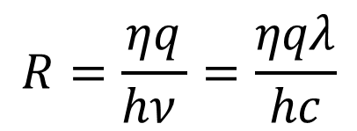
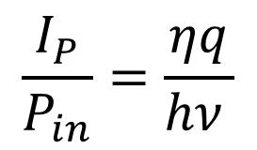
Responsivity
$$η=\frac{{I_{p}}/q}{{P_{in}}/hν }=\frac{I_{P}}{q}\frac{hν }{P_{in}}$$
$$\frac{I_{P}}{P_{in}}=\frac{ηq}{hν }$$
$$R=\frac{ηq}{hν }=\frac{ηqλ}{hc}$$
where: R = theoretical maximum responitivity in Amps/Watt η = quantum efficiency λ = wavelength in nanometers
q=1.6x10⁻¹⁹, h=6.63x10⁻³⁴, c=3x10⁸

Slide 8
Responsivity gives transfer characteristics of detector i.e. photo current per unit incident optical power.
Typical responsivities of PIN photodiodes are
Silicon PIN photodiode at 900 nm → 0.65 A/W
Germanium PIN photodiode at 1300 nm → 0.45 A/W
InGaAs PIN photodiode at 1300 nm → 0.9 A/W

Slide 9
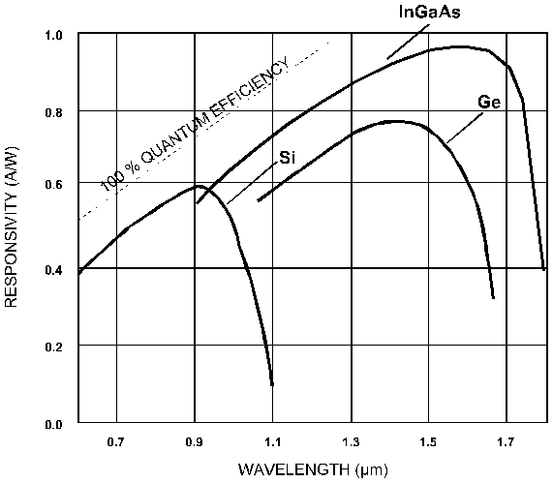
Photodetector - Characteristics
2. Quantum Efficiency
Quantum Efficiency - ratio of primary electron-hole pairs created by incident photons to the photons incident on the diode material
number of electrons-hole pairs generated
number of incident photons
Typical Spectral Response of Various Detector Materials
where r_{p} is the incident photon rate (photon per second) and r_{e} is the corresponding electron rate (electrons per second)
I_{p} is average photo current ; P_{in} is average optical power incident on photodetector

Slide 10
Absorption coefficient of material determines the quantum efficiency.
Quantum efficiency η < 1 as all the photons incident will not generate e-h pairs. It is normally expressed in percentage.
Quantum Limit : For an ideal photodetector having quantum efficiency η = 1 and has zero dark current (i.e no output when light is absent), then the minimum received power for a specific bit-error rate is known as Quantum Limit

Slide 11

Photodetector - Characteristics
3. Cut-off wavelength (λ_{c})
Any particular semiconductor can absorb photon over a limited wavelength region. The highest wavelength is known as cut off wavelength (λ_{c}). The cut-off wavelength is determined by bandgap energy E_{g} of the material.
where,
Eg in electron volts (eV) and
λ_{c} cut off wavelength (micrometers)
Typical value of λ_{c} for silicon is 1.06 µm and for germanium it is 1.6 µm
The photodiode of long cut off wavelength can emit optical power in wide range that is used for fiber optic transmission.
$$λ_{c}=\frac{hc}{E_{g}}=\frac{1.24}{E_{g}}$$

Slide 12
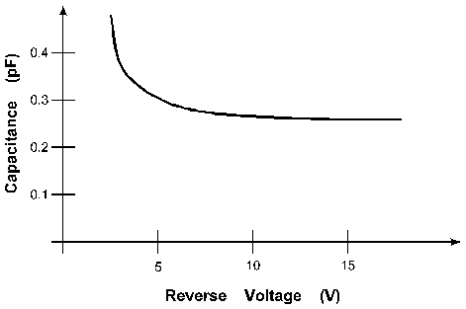
Photodetector - Characteristics
4. Capacitance of a detector
dependent upon the active area of the device and the reverse voltage across the device.
A smaller active diameter makes it harder to align the fiber to the detector.
Also, only the center should be illuminated
photodiode response is slow at the edges.
Capacitance versus Reverse Voltage

Slide 13
5. Response Time
Photodetector - Characteristics
Time needed for the photodiode to respond to optical input and produce an external current
Dependent on
photodiode capacitance
load resistance
design of photodiode
Measured between 10% and 90% of amplitude
Vout
90%
10%
Time
Rise Time
Fall Time

Slide 14
Problems
Calculate the theoretical maximum responsivity of a detector at 1550nm. Ans: 125 A/W
Calculate the -3dB frequency and rise time of a detector with a capacitance of 0.5pF operating into an impedance of 50W.
Calculate the responsively of a detector with quantum efficiency of 10% at 800 nm.
Ans: 6.45 A/W
A detector operating at 800 nm produces an output current of 80 A for an incident light beam of power 800 W. Calculate the quantum efficiency and responsivity of the detector.
Ans: 0.1 A/W , 15.5%
Ans: 1.25 A/W, 0.661 A/W, 6.4 GHz

Slide 15
The PIN Photo-Detector
The PIN photodiode is structured with p and n regions separated by a lightly n-doped intrinsic (i) region.
Incident photon with energy ≥ band-gap energy of the photodiode will generate free electron-hole pairs, known as photo-carriers.
The high electric field present in the depletion region causes the carriers to separate and be collected across the reverse-biased junction.
This gives rise to a photo-current flow in an external circuit, with one electron flowing for every carrier pair generated.
In the absence of light, PIN photodiodes behave electrically just like an ordinary rectifier diode. If forward biased, they conduct large amount of current.

Slide 16
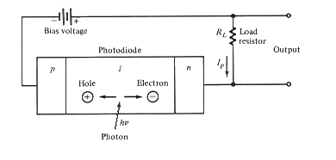
The PIN Photo-Detector
Schematic representation of a PIN photodiode circuit with an applied reverse bias.

Slide 17
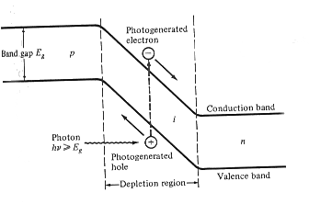
The PIN Photo-Detector
Simple energy-band diagram for a PIN photodiode. Photons with energy > band-gap energy can generate free electron-hole pairs.

Slide 18
The PIN Photo-Detector
Operating Modes:
PIN detectors can be operated in two modes
Photovoltaic Mode
Photoconductive Mode
1. Photovoltaic Mode:
No bias is applied to the detector.
In this case, the detector works very slow and output is approximately logarithmic to the input light level.
Real world fiber optic receivers never use the photovoltaic mode.
2. Photoconductive Mode:
The detector is reversed biased.
The output in this case is a current that is very linear with the input light power.
The intrinsic region somewhat improves the sensitivity of the device. It does not provide internal gain. The combination of different semiconductors operating at different wavelengths allow the selection of material capable of responding to the desired operating wavelength.

Slide 19
The PIN Photo-Detector
Diffusion Length:
As the charge carriers flow through the material, some electron-hole pairs will recombine and disappear.
On the average, the charge carriers move a diffusion length L_{n} or L_{p} for electrons and holes, respectively.
Carrier Life time:
The time it takes for an electron or hole to recombine is known as the carrier lifetime and is represented by τ_{n} and τ_{p}, respectively.
The lifetimes and the diffusion lengths are related by
L_{n} = (D_{n}τ_{n})^{1/2} and L_{p} = (D_{p}τ_{p})^{1/2}
where D_{n} and D_{p} are the electron and hole diffusion coefficients, expressed in units of cm²/sec.

Slide 20
The PIN Photo-Detector
Optical power absorbed
Optical radiation is absorbed in the semiconductor material according to the exponential law
P(x) = P_{o}[1 - exp(-α_{s}(λ)x)]
Here, α_{s}(λ) is the absorption coefficient at wavelength λ,
P_{o} is the incident optical power level, and
P(x) is the optical power absorbed in a
distance x.

Slide 21
The PIN Photo-Detector
The optical absorption coefficient versus wavelength is shown in Fig. or several photodiode materials.
The cutoff λ_{c} is determined by the band-gap energy E_{g} of the material:
λ_{c}(mm) = hc/E_{g} = 12.4 / E_{g}(eV)
The cutoff wavelength is about 1.06-µm for Si and 1.6-µm for Ge.
For longer wavelengths, the photon energy is not sufficient to excite an electron from the valence to the conduction band.

Slide 22
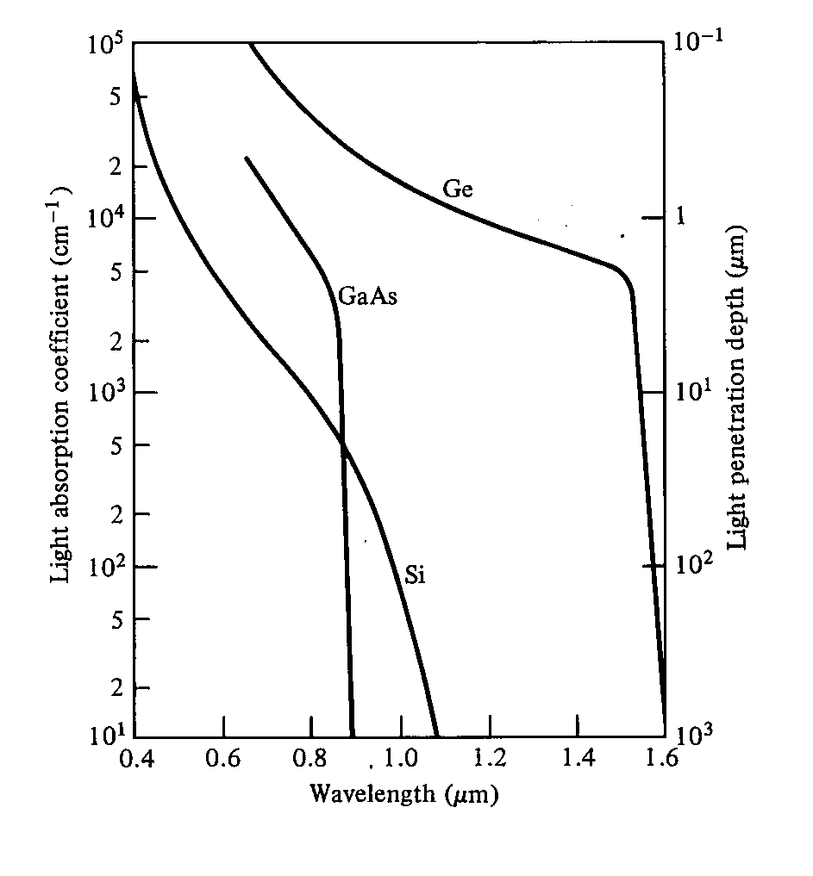
Optical absorption coefficient as a function of wavelength for Si, Ge, and GaAs.

Slide 23
Avalanche Photodiodes
When a p-n junction diode is applied with high reverse bias, breakdown can occur by two separate mechanisms.
Direct ionization of the lattice atoms → Zener breakdown
High voltage carriers causing Impact Ionization of the lattice atoms → Avalanche breakdown.
APDs uses the avalanche breakdown phenomenon for its operation. The APD has its internal gain which increases its responsivity.

Slide 24
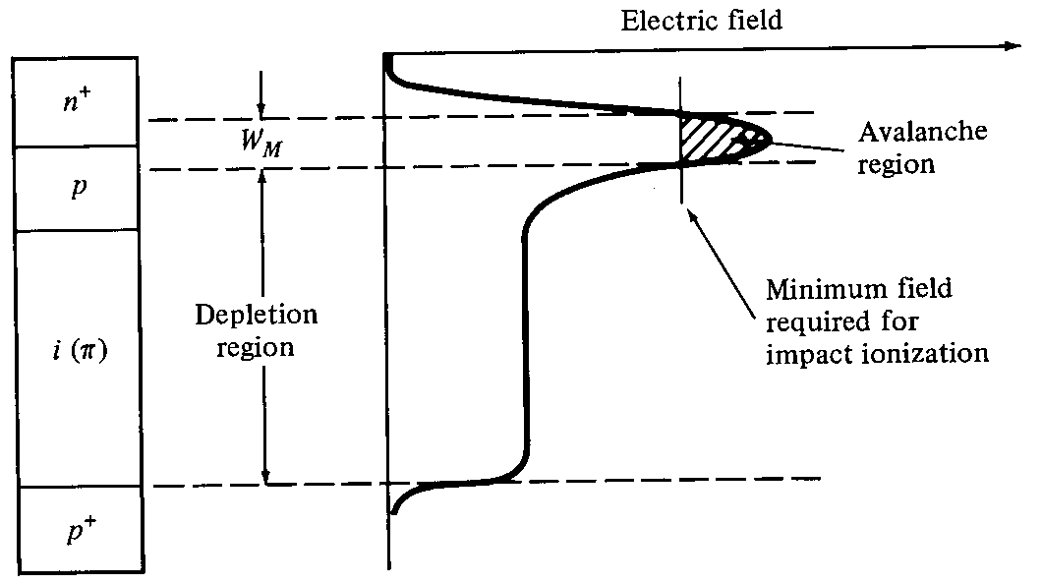
Avalanche Photodiodes
Reach-through avalanche photodiode structure and the electric fields in the depletion and multiplication regions.

Slide 25
Avalanche Photodiodes
The fig. shows the schematic structure of an APD. By virtue of the doping concentration and physical construction of the n⁺ p junction, the electric field is high enough to cause impact ionization.
Under normal operating bias, the I-layer is completely depleted.
This is known as reach through condition, hence APDs are also known as Reach through APDs or RAPDs.

Slide 26
Avalanche Photodiodes
Impact Ionization:
The photo generated carriers traverse a region where a very high electric field is present. These carriers can gain enough energy under high electric field and excite new electron-hole pairs. This phenomenon is called Impact Ionization
Avalanche Effect:
During Ionization new generated carriers also accelerated by high electric field and gain enough energy to cause further impact ionization. This phenomenon is called avalanche effect.

Slide 27
Avalanche Photodiodes
In normal usage, the RAPD is operated in the fully depleted mode. Light enters the device through the p⁺ region and is absorbed in the p material, which acts as the collection region for the photo-generated carriers.
The photo-generated electrons drift through the p region in the pn⁺ junction, where a high electric field exists.
It is in this high-field region that carrier multiplication takes place.

Slide 28
Avalanche Photodiodes
The average number of electron-hole pairs created by a carrier per unit distance traveled is called the ionization rate.
Most materials exhibit different electron ionization rates α and hole ionization rates β.
The ratio k = β/α of the electron and hole ionization rates is a measure of the photo-detector performance.
APDs constructed of materials in which one type of carrier largely dominates impact ionization exhibit low noise and large gain-bandwidth products.

Slide 29
Similar to PIN photodiode, light absorption in APDs is most efficient in I-layer. In this region, E-field separates the carriers and the electrons drift into the avalanche region where carrier multiplication occurs.
If the APD is biased close to breakdown, it will result in reverse leakage current. Thus APDs are usually biased just below breakdown, with the bias voltage being tightly controlled

Slide 30
Avalanche Photodiodes
Avalanche Multiplication:
The multiplication M for all carriers generated in the photodiode is defined by M = I_{M} / I_{p} where I_{M} is the average value of the total multiplied output current and I_{p} is the primary unmultiplied photocurrent.
Responsivity:
The performance of an APD is characterized by the responsivity given by
R_{APD} = (ηq/hν)M = R_{o}M
where R_{o} is the unity gain responsivity.

Slide 31
Advantages and Disadvantages of APD
Advantages:
Excellent linearity over optical power range from nano watts to several microwatts.
Better sensitivity (5 to 15 dB)
Wide range of gain variation
APD offers internal gain
Better Signal to Noise ratio
Disadvantages:
Due to complex structure, fabrication is difficult
APD and supporting circuitry is more expensive
Random nature of gain mechanism contributes additional noise
High voltage (50 to 400 V) and temperature compensation is needed for stabilization
Internal gain of APD is temperature dependent.

Slide 32
Comparison of PIN and APD
S. No | Parameters | PIN | APD
1 | Sensitivity | Less sensitive (0-12 dB) | More sensitive ( 5-15 dB)
2 | Biasing | Low reverse biased voltage (5 to 10 V) | High reverse biased voltage (20 – 400 volts)
3 | Wavelength region | 300 -1100 nm | 400 – 1000 nm
4 | Gain | No Internal gain | Internal gain
5 | S/N Ratio | Poor | Better
6 | Detector Circuit | Simple | More complex
7 | Conversion efficiency | 0.5 to 1.0 A/W | 0.5 to 100 A/W
8 | Cost | Cheaper | More Expensive
9 | Support circuitry required | None | High voltage and temperature compensation

